Slide 1

PHARMACY MANAGEMENT SYSTEM
PRESENTED BY :-
VARUN NAIR(21BTRCS094)
VARUN SHARMA(21BTRCS095)
UTKARSH SHARMA(21BTRCS089)
UDIPTA DAS(21BTRCS088)

Slide 2
Abstract:
A java application for pharmacy is an application that can be accessed throughout the organization and especially by pharmacists well with proper login provided when needed. Using pharmacy management system the pharmacist can easily identify the location of the various medicines kept and reduce the time needed for searching manually. The stock availability of the medicines can also be identified easily. The new medicines available and the expiry dates can also be tracked.

Slide 3
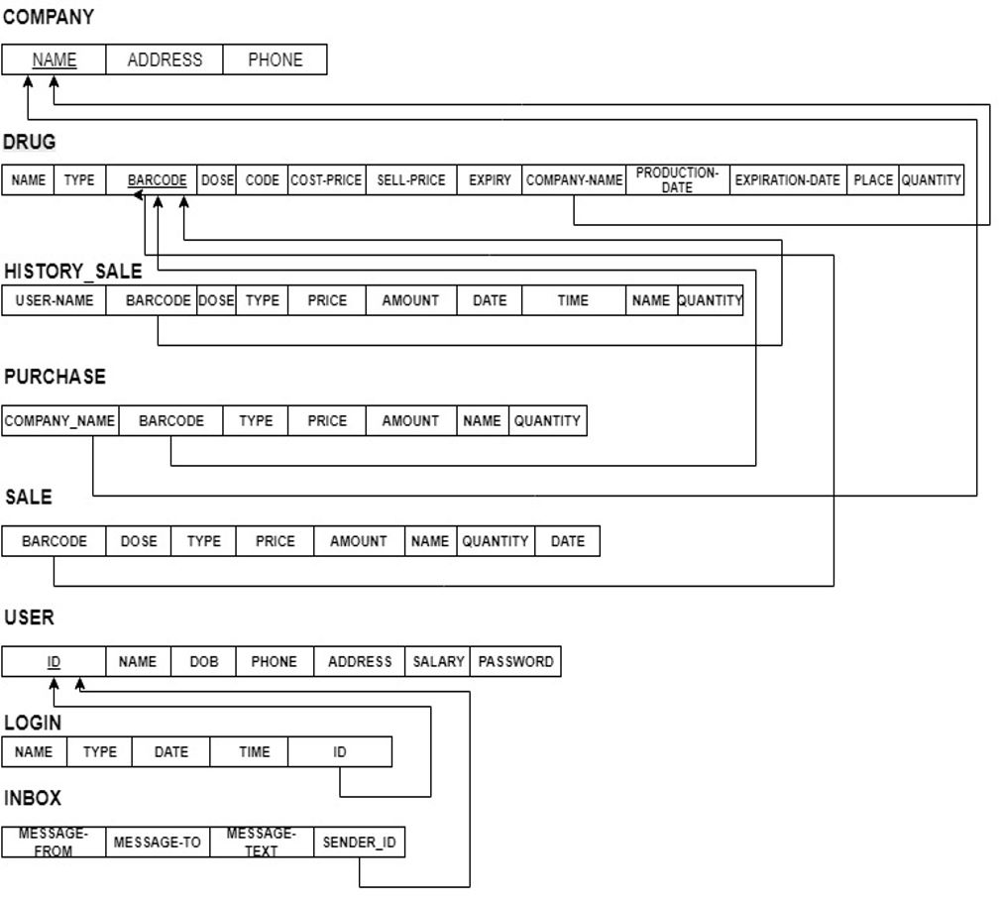
SCHEMA DIAGRAM:

Slide 4
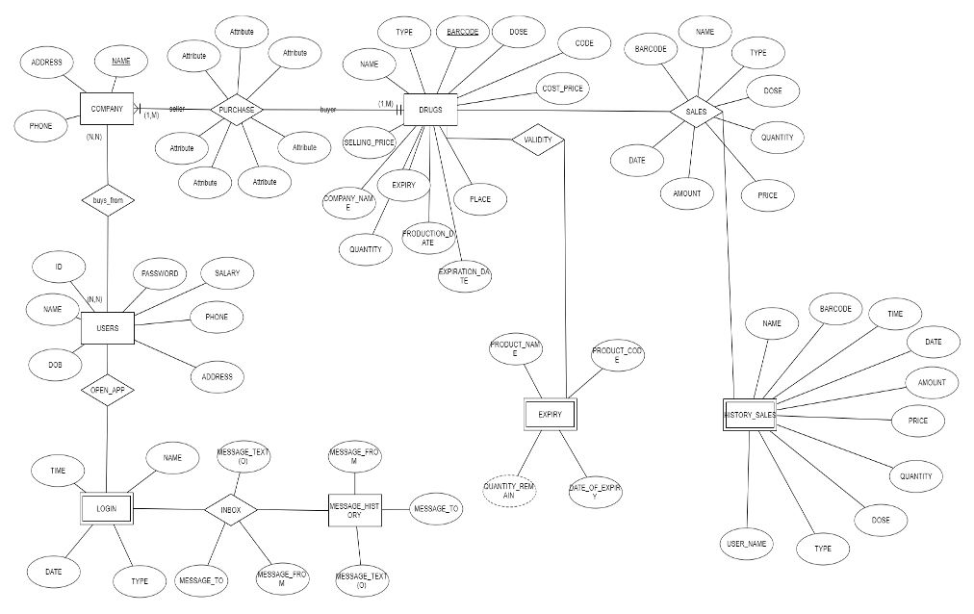
ER-DIAGRAM :

Slide 5
OBJECTIVE OF THIS PROJECT:
This Pharmacy management system system facilitates pharmacies to maintain the functionality related to pharmacists and the database consisting of various medicines.
1) Providing a smart technology pharmacy management system.
2) Pharmacy management system provides the easiest way to manage all functionalities of a pharmacy.
3) This application will help to reduce wastage cost of medicines and be easier to manage for the pharamacist.
4) This project falls under the category of database and java swings.

Slide 6
EXISTING SYSTEM:
Low level databases are existing which are tougher to manage and are used across hospitals and pharmacies.
This reduces the time taken by pharmacists for management which increase wastage of medicines and makes it harder to keep track of stock and expiry of the same.

Slide 7
PROPOSED SYSTEM:
Application technology which is beneficial for pharmacy management system.
The proposed system consists of some modules: Admin Panel and Main Panel.
Pharmacists can view all details including medicinal details such as name,stock,description,etc.
The management and monitoring of medicines would be much easier for hospitals, pharmacies as well as the pharmacist.

Slide 8
ADVANTAGES OF PROPOSED SYSTEM
Provides an easy platform for pharmacist and medicines
Easy and fast updating of medicinal stock for better communication between pharmacist and the patient.
Updating name of medicines, stock , new medicines , date of expiry.

Slide 9
DISADVANTAGES OF EXISTING SYSTEM
It is manual process for the pharmacist.
It is harder to keep track of various medicines available at the same time.
It is a slow system and hard to manage the database.

Slide 10
MODULE LIST:
ADMIN:
Login
View admin details
View medicinal details
View availabilty of medicine
View name and expiry.
Place of medicine stored.

Slide 11
FUTURE ENHANCEMENT
1) In adding more features for pharmacy management system for better management and ease of use.
2) To authenticate the pharamacists based on the system admin list which is maintained by the operating system.
3) Project can be made more robust and biometerics can be included.

Slide 12
Result:
The project entitled as pharmacy management system is the system that deals with the issues related to pharmacies.
This project is successfully implemented with all the features mentioned in system requirements specification. Awareness and right information about any medicine is essential for both the development of health industry as well as the pharmacists.

Slide 13
CONCLUSION
The project entitled as Pharmacy Management System is the system that deals with the information of all medicinal details.
System leads to instant updates for all medicines any where physically for efficient organisation.

